Slide 1
Comparative Study
Olivia Hernandez

Slide 2
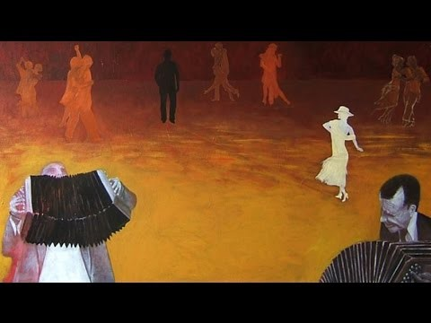
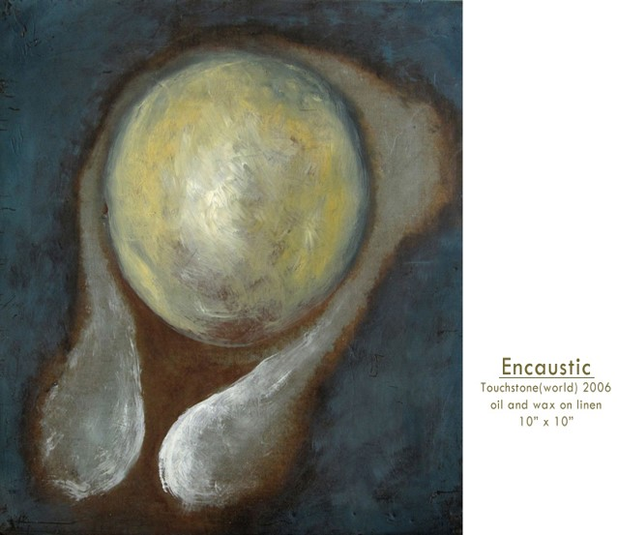
Pacia Sallomi (Tango Colores)
Pacia Sallomi works are influenced by her life experiences, cultural influences and background. Her works combine multiple colors and movement, all of her works in the Tango Colores series are oil paintings on different textured canvases. Sallomi has knowledge of different dance styles such as; belly dancing, African style dancing, and ballet, these different dance styles influence her works and the colors in each piece represent the tradition and culture in which they are from.
Tango colores
oil paint
Pacia Sallomi

Slide 3
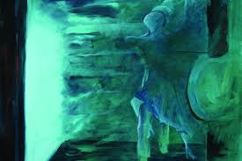
Technique and Style
Pacia Sallomi uses very smooth brushstrokes to create movement within the dancers, while positioning the dancers in mid action allowing the viewer to look in. Sallomi’s works contain both a light and dark area which create depth, in helping to express a story drawing the viewer’s attention to the main focal point.
The works of Sallomi’s that I am focusing on are from her series Tango Colores which focuses on movement and style of dance . Sallomi captures moments of dance between the dancers and distorts the image by blurring them and blending them within the background creating a non-existent and fading away appearance. By using the same colors for the background and the main two characters Pacia Sallomi creates an overall mood, this particular work uses cold colors which is the artist way of creating a mood of sorrow, and longing, and complete loneliness to the work. By having two dancers close together and fading expresses a state of separation, to represent sorrow and add emphasis to the dance itself.
Multiple shades of blue. Adds depth and the use of non typical “tango” colores adds a new meaning and representation to the piece, creating an emotion of sorrow and mourning.
The Many colors of tango
Oil paint on canvas
Pacia Sallomi

Slide 4
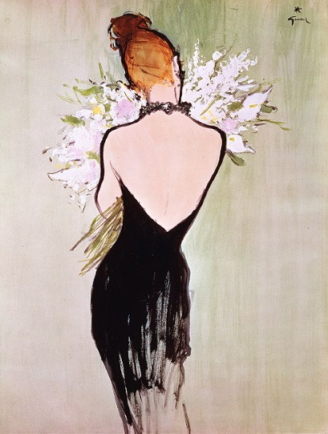
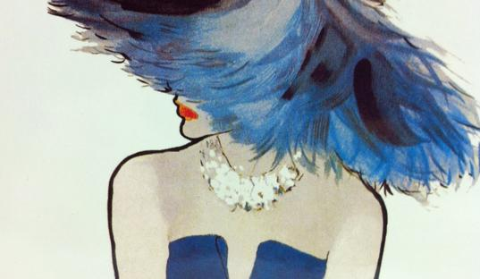
Rene Gruau
Rene Gruau ‘s main inspiration came from fashion his works were centered on clothing and the uniqueness as well as the advertisement for fashion.
Rene Gruau works have many similarities within each other his ¨signature style¨ is of either a man or woman half hidden or turned allowing there to be mystery, this also intrigues the viewer causing them to pay more attention to the works.
There are multiple shades of blues to add texture and create movement.
SARL by Rene Gruau
Fashion pieces both have a main focal point. (back & neck)
From wedding inspiration series
Acrylic paint on canvas
By Rene Gruau

Slide 5
Technique and Style
Rene Gruau was influenced by the world of fashion and advertisements, so many of his works contain a bold fashion statement piece or necklace to accentuate the clothing. Rene Gruau creates contrast in his works by having a darker background and a vibrant focal point. By doing this Gruau creates highlights within the piece, you are able to get a true sense of Rene Gruau’s passion for clothing by his bold color choice and fashion ideas.
A common theme amongst Rene Gruau works is that the clothing is the main focal point, and everything else helps to highlight and brighten the painting as a whole. In many of Rene Gruau works his models have a very seductive look and really draw the viewer in by the positioning and unique clothing. The clothing itself is very detailed, Rene Gruau adds depth to the clothing by using short brush strokes and multiple shades of the same color for a layering effect.

Slide 6
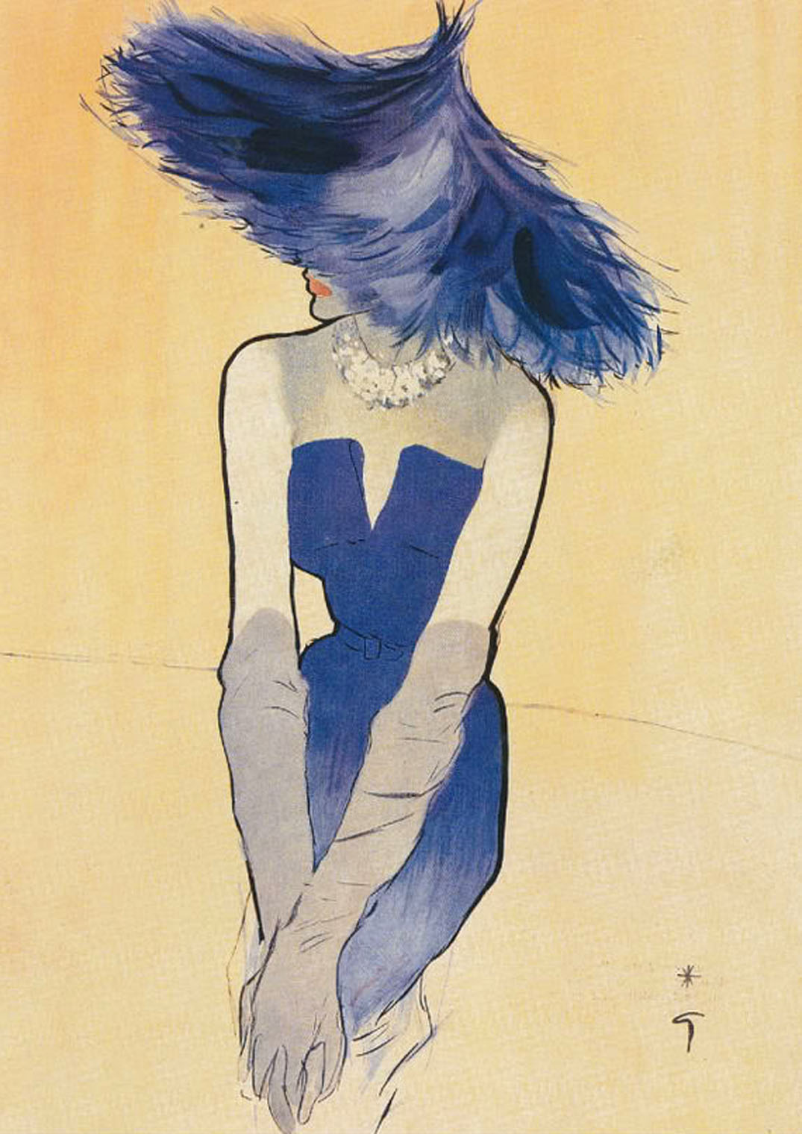
Pacia Sallomi and Rene Gruau comparison
Both artist draw the viewer in by color choice and figurine. The color is important with Sallomi’s work to replicate culture and mood where Gruau uses the background and clothing color to not only brighten but to draw attention to the work. Comparing the two works show how each artist showed little attention to facial features and more to the position of the body and the light vs dark. Also using dark and light tones to create movement as well as depth to areas. They both use short and long brushstrokes to elongate and create detail.
Movement “flow” created by multiple colors and short brush strokes.
From wedding inspiration series
Rene Gruau
The many colors of tango
Pacia Sallomi

Slide 7
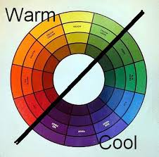
Color
The works had a combination of three main colors, keeping a certain consistency as well as making the work appealing. Tango colores had individual pieces that used warm colors while others used cold colors. Rene Gruau used black and white through all his works and one accent color and then mixed colors that were near his main color to create definition and add a textual illusion. Pacia Sallomi works incorporated dancers and each piece was done in a solid color with details similar to that color, to accentuate the dance, and figurines. Rene Gruau works combined multiple colors, due to his passion for fashion and his keen eye to detail and contrast from the clothing and background.

Slide 8
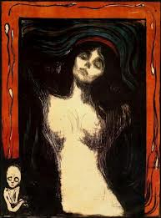
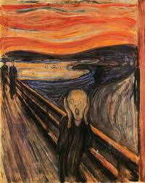
Edvard Munch
Edvard Munch is known for his ability to tell a story, while creating beautiful images with multiple colors. These works are done by Edvard Munch, yet they look very different due to the image itself and Munch’s color pallet. The background of both pieces are “blurred” and swirled causing the focus to be on the person in front. The faces are very subtle and yet have a huge impact on the painting and express emotion. The Scream is very vibrant and has a lot going on, this creates meaning as to the surrounding of the man and makes the viewer question Edvard Munch and his life.
Madonna
By Edvard Munch
The Scream
By Edvard Munch

Slide 9
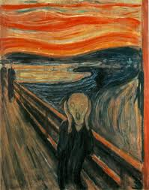
Technique and Style
Edvard Munch uses long brush strokes to fill in the background while adding short quick brushstrokes to add texture and create movement. Then creates depth by using a wide range of colors, this gives an illusion of the background moving and the focus is than on the main person The Scream. Which creates the question of why is the man screaming? An assumption of why the man is screaming could be that the world he lives in is confusing and he feels lost, and that he is simply going through the motion of everyday life, trapped within a place he doesn’t belong. In the painting of Madonna Munch saturates the background creating the main focus to be on the face, then positions the head and body perfectly center. Making the face very detailed with a calm expression, although Edvard Munch made The Madonna using less color he still amplifies it by the gradation of the black which contrast against her pale white skin.
Use of warm and cool colors adds contrast to the piece.
Creates movement in the background(brush strokes)
The Scream
Edvard Munch

Slide 10
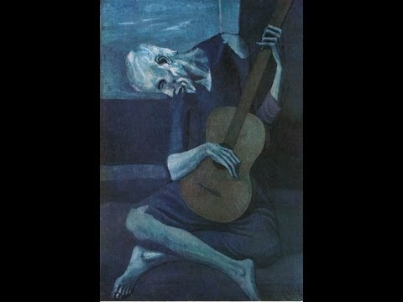
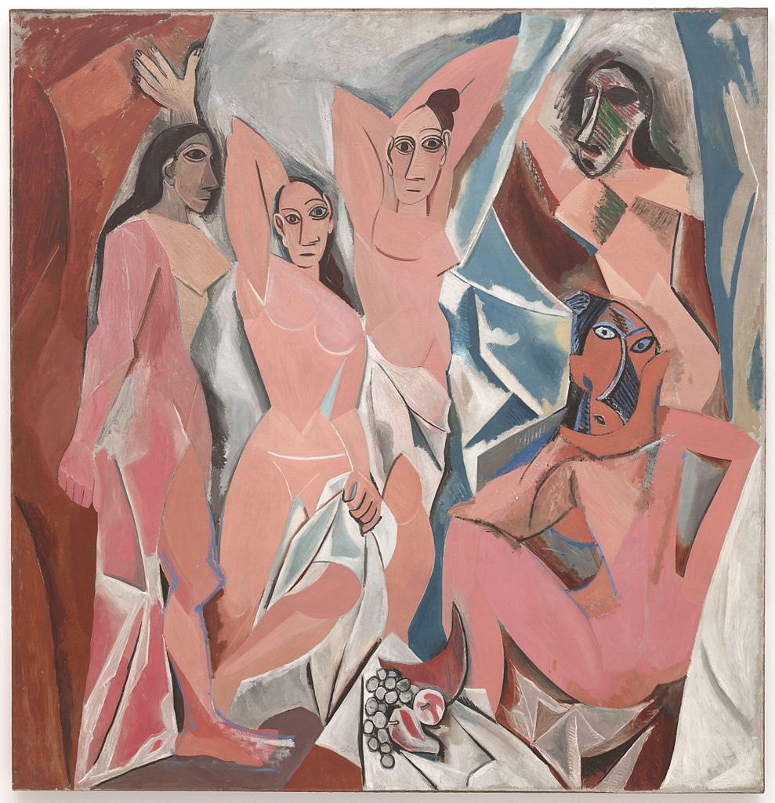
Picasso
Picasso and his style was very different from the last few artist I have talked about, for instance he uses color to create emotion and add a mood to his works.
There is so much detail within the face that he really captures the man’s expression, Picasso moves within each new art movement so his works can differ from one another significantly.
These works are different sides of Picasso and help in showing how versatile he was as an artist and how solid his works were but also how he had the ability to add depth and focus so much on the detail.
The Old Guitarist
By Pablo Picasso
Les demoiselles d’avignon
By Pablo Picasso

Slide 11
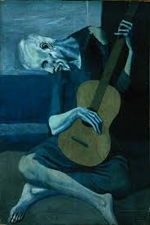
Technique and Style
Picasso style was very unique because unlike most artist his style changed drastically with each new art movement, he also had work that could range from realism to an almost “childlike”style. Picasso style was very straightforward he created paintings and “matched” them with a color that represented mood and expressed emotion in his works. He uses multiple colors to add depth and to represent different aspects and features within the works. Picasso blends color to create emphasis on bone and muscle structure, and highlights other areas of the human figure with lighter shades of the same color.
Picasso adds defined muscle and movement to add pain to the figure and create a tone to the piece
Color: the color itself expresses emotion and tone with the detail of the man and him being an older gentlemen with no shoes. Picasso gives clues within his works so that the viewer can create a story when looking at his work.
The Old Guitarist
Pablo Picasso

Slide 12
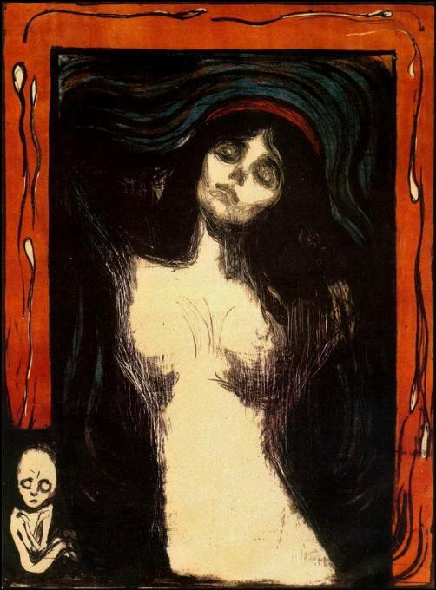
Comparison of Munch and Picasso
In order to create detailed backgrounds Munch and Picaso use bold, solid colors, this creates a foundation for the main focal point, without taking away from it,but to enhance it. Unlike Munch Picasso’s works dont have that detailed background the focal point is usually most detailed and the largest part on the canvas, with that said that means that Picasso has larger details and can express emotion on a larger platform.
color is more solid with white highlights and cartoon features
Cubist Style
Perception and style differs and changes meaning of both works.
Color movement and focus is in the center
Les demoiselles d’Avignon
By Pablo Picasso
Madonna
By Edvard Munch

Slide 13
Color
In Edvard Munch’s ‘the Scream’ it is filled with multiple colors creating the illusion of this place that is in between moving rapidly that it helps interpret the mood and creates information for the viewer to make assumptions as to what it means and what he is trying to say. With his ‘Madonna’ piece the colors are very dark and the figure in the lower left hand corner help create an earing feeling. The artist use every color and when Picasso creates works he is known for his “period” works. His period works are when he created a series or multiple works using the same color they also had a similar theme or message and flowed together, being a similar style. Like Picasso Edvard Munch is not afraid of color or afraid to incorporate a work using multiple colors, he like many artist use the colors to highlight and add features and give a certain type of depth to the piece.
Mixture of colors
The scream
Edvard Munch
The Old Guitarist
Picasso
Multiple shades

Slide 14
Comparison of all Artist
Color is important and all the artist use multiple colors to add and create depth and detail. The background of the paintings are just as important and help create a very clear focus. All the works have a certain style and are so intriguing that they all visually look as if the artist are hiding something. The works themselves are different but they all incorporate the artist's passion for Sallomi it is dance, for Gruau it is fashion, Munch is color and quick strokes, and for Picasso it is his ability to flow with each movement. In researching and combining the artist movements I have discovered and found when creating detail or when adding depth to a work that using different shades of either the same color or different colors draws the eye in and gives the illusion of movement. Also these artist were mocked and criticized for their works but remained true to themselves and their works. These artist were able to create art based off their passion while allowing a story to be told.

Slide 15
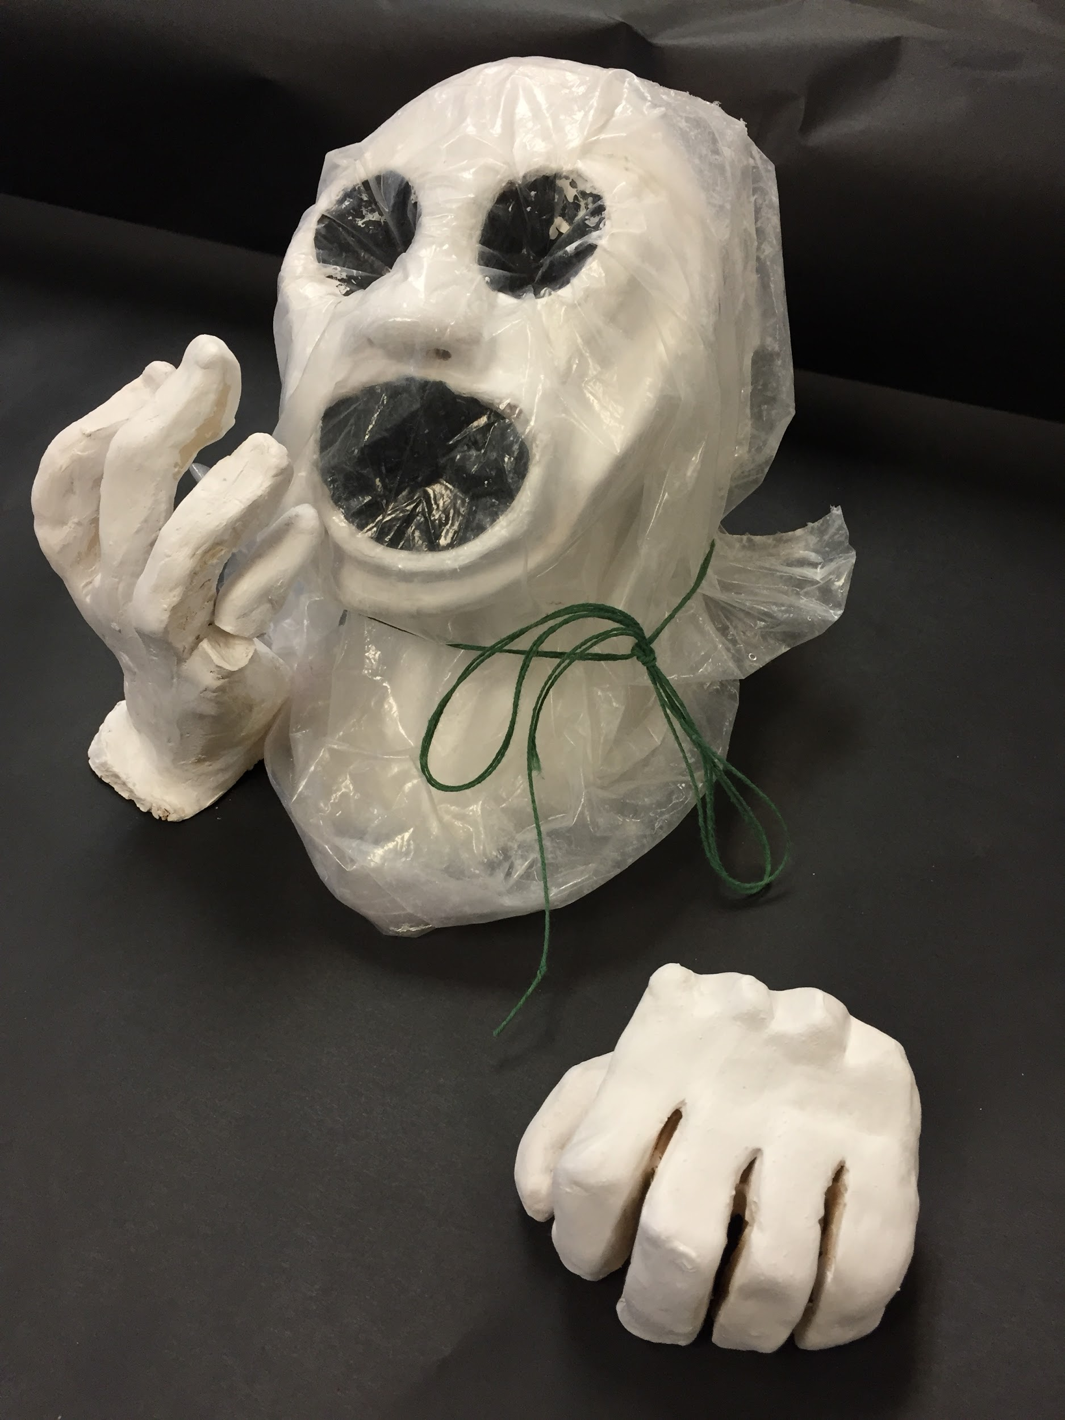
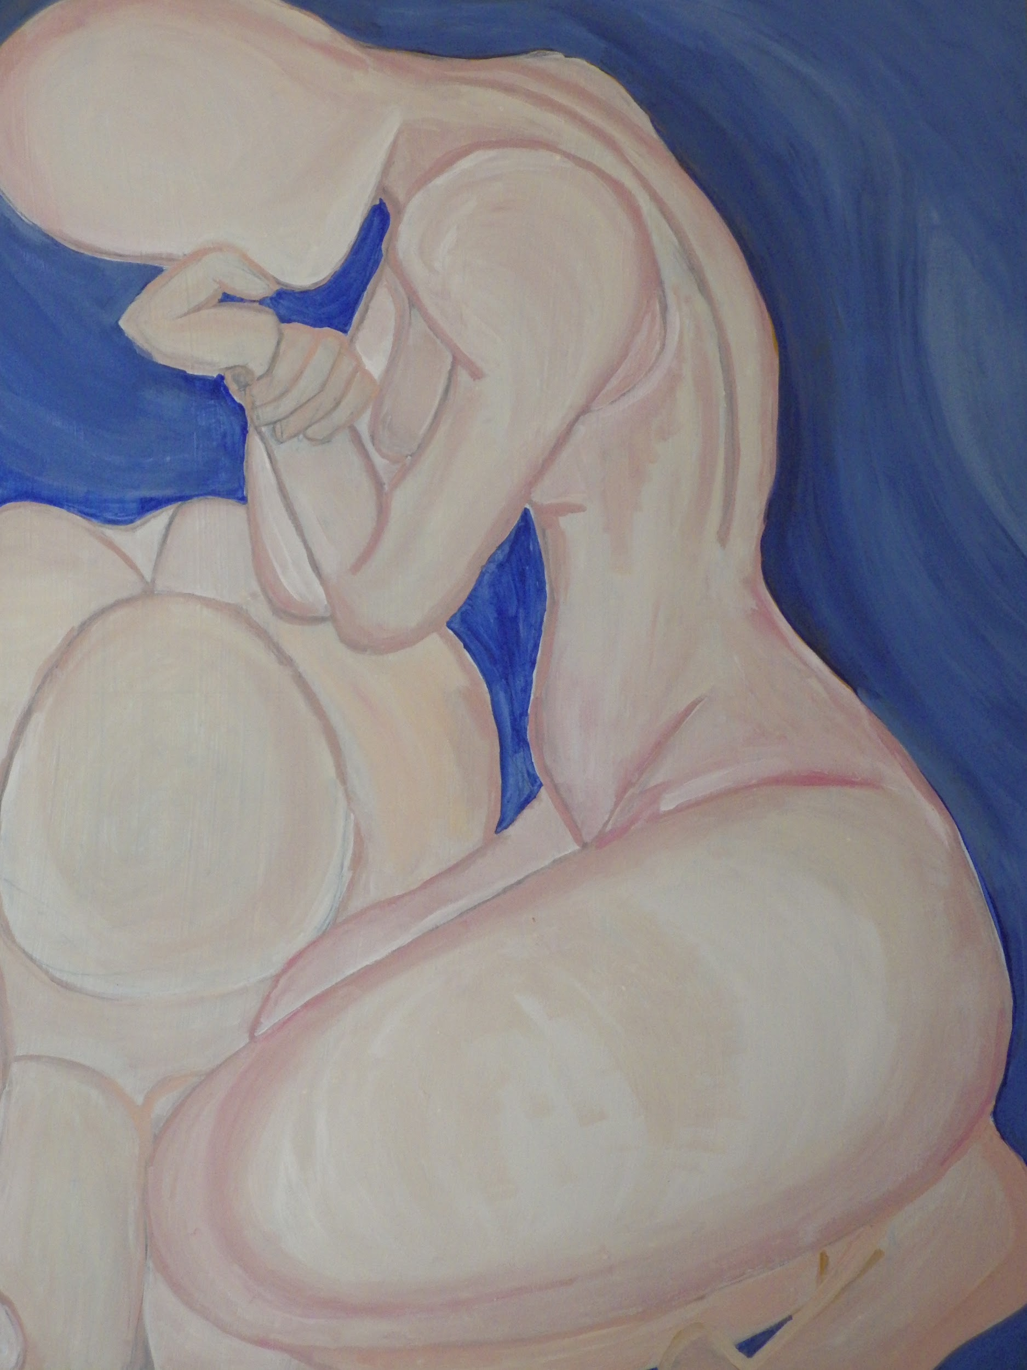
Influence over personal works
Major influences from the artist works were the use of colors and the combination of colors to create depth and add detail. Positioning of the body and proportion played a huge role in many of my works when replicating and using the artist for inspiration. As well as being influenced and using society and what is recommended and what we are being conformed to and what passions I had it helped on allowing me to express my own emotion and passion within my works.
(My interpretation)
Save Me
The Many colors of Tango
Pacia Sallomi
The Scream
Edvard Munch

Slide 16
Connection to Pacia Sallomi
The work in the upper right hand corner is my work, it is done with acrylic paint .The inspiration for this piece was Pacia Sallomi and her serie Tango Colores. Sallomi was able to create works with a smooth texture, and solid color. This became my inspiration and the main detail of her pieces in which I was influenced by. In Pacia Sallomi’s painting The many colors of Tango Sallomi uses cold colors. The different shades of blue add emotion to the painting and allow the viewer to make assumptions based off of color and position. Due to her specific color choice and the representation behind them, I decided as well to replicate and play off of the emotional aspects that the colors can signify. In doing so warm and cold colors balance one another while creating contrast from the darkness of the blues, with the warmness of the light pink. Each brushstroke creates movement to the piece which allows the eye to flow when looking at the work.
Multiple shades add depth and emotion. (like stages)
The Many colors of Tango
Pacia Sallomi

Slide 17
Connection to Edvard Munch
The inspiration behind this piece is Edvard Munch’s The Scream, only this piece is done in clay. This was my first time working with clay, and with working with clay I discovered that once in the “oven” the piece had a possibility of exploding this then made doing this more stressful.
When replicating The Scream my main focus was on the face itself, it stood out in the original. Proportion wise it was difficult to enlarge the head and create hands to express the pain that Edvard Munch so easily creates in his painting. Working with clay gave me less opportunity to add color and create a “background” I used that as an advantage to create more detail with the face and it’s expression and allowed me to incorporate other objects when presenting it. In order to create depth and illusion, I painted the inside of the mouth, and eyes black. My interpretation of The Scream is a painting of someone who is just going through the motions of everyday and the world around him is going and he is not really in or out, he has no significance in the world. Which is why I incorporated the bag to represent the world and how we suffocate by it and the fear we all have of death, or life in general.
Save Me
Olivia Hernandez

Slide 18
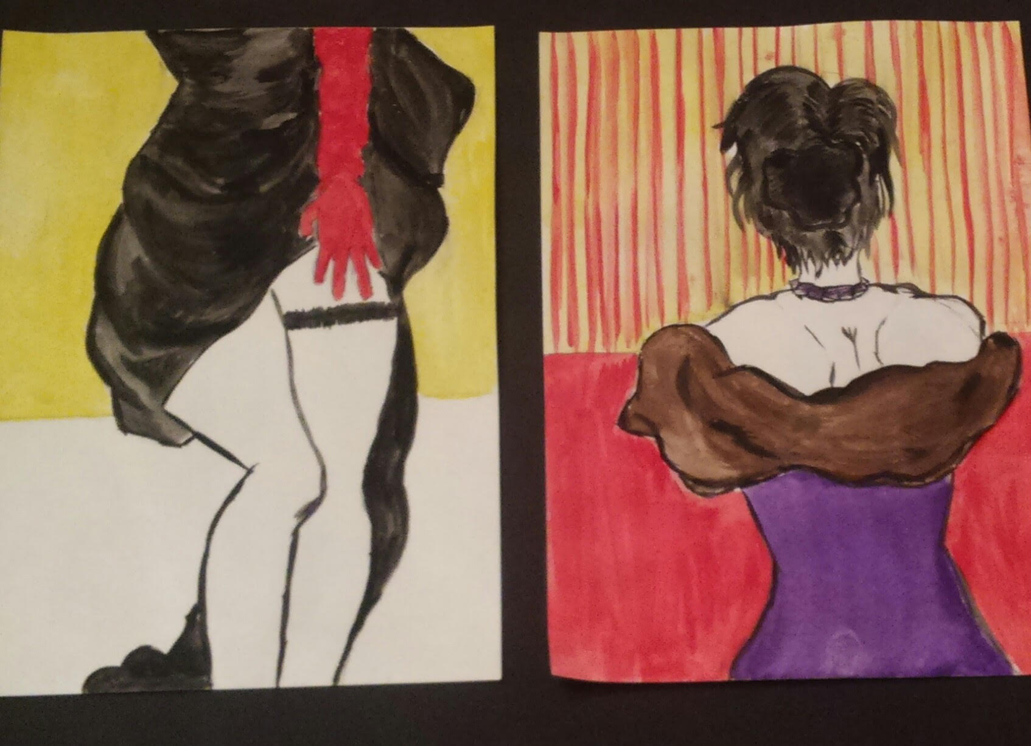
Connection to Rene Gruau
The image on the left is a replication of a fashion illustration that Rene Gruau painted. His fashion and bold color was something that inspired my works, in order to grasp the viewers attention. The human body also became something that stood out to me because Rene Gruau uses the female body to show beauty and grace while creating something “scandalous” with the revealing of skin.
When creating these pieces I focused on drawing the viewer in, so bold colors help highlight the women. The paintings are done in watercolor, this was a first but I really wanted it to be vibrant and for the bold fashion to stand out.
Join the Party
By: Olivia Hernandez

Slide 19
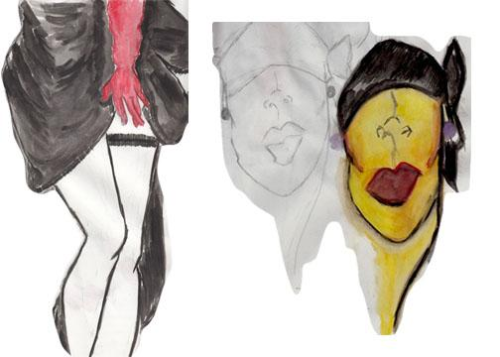
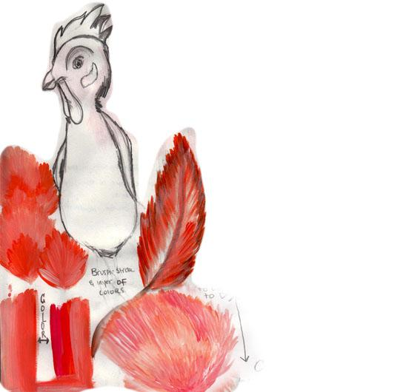
Working with different Mediums
Different Mediums: Clay, Paint, Watercolor, Acrylic paint, Photography and Found Object
When working within different mediums helps you to create a signature style and technique. It also helps express your imagination, like when working in clay helps to imagine something in 3-D that will be viewed from multiple angles. The different mediums limits you to what tools you can use when creating a work. When working with clay all you have to use is water, and small plastic carving tools, where both watercolor and acrylic paint limits you to just using the paint and water. When painting the most common brushstroke were quick short brushstrokes. The short brushstrokes add depth and create a textured look, to add layers to a painting the colors within the section have to be similar or different shades of the same color so when layered they look textured.
Use of different shades to add texture and create layers to the works. In both watercolor and acrylic

Slide 20
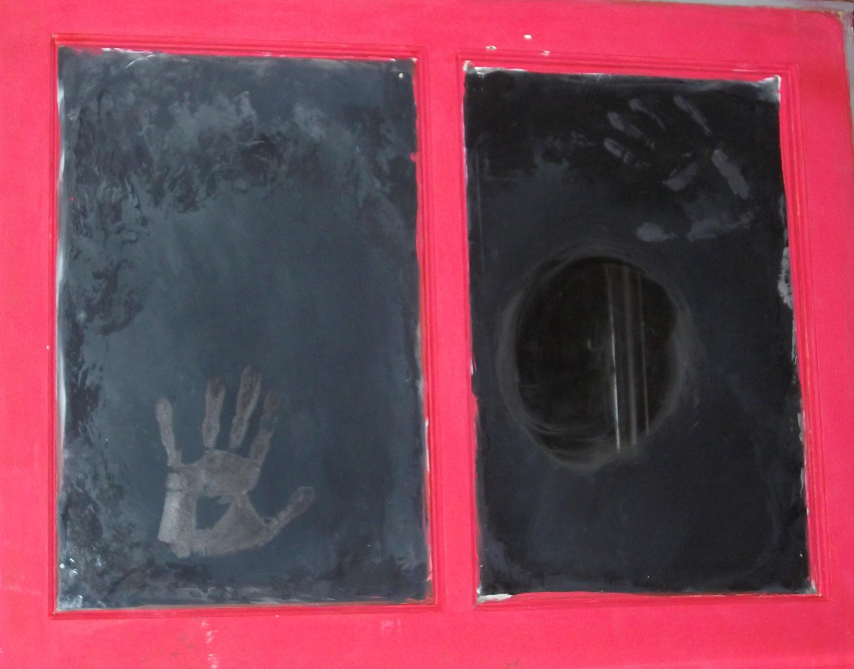
Overall Reflection
The journey from taking art junior and senior has helped developing me into the artist I am, from the technique and style to the reasoning behind my works. The semester has taught me that art captures a moment in time, and whether it’s big or small it has meaning and significance, for some art captures the artist's passion or inspiration Art is a way to express culture and a way for people to express themselves, it’s a way for people to leave something behind, and to share a rare moment or an idea.
When developing each individual art work I tried to stay within a theme or within the same color pallet so that the pieces together flowed as a unit. But in trying to do this I had a hard time being inspired, so eventually I decided to just make what spoke to me within the moment. That explains the range of different colors and different styles. I was really influenced by art that allowed each individual viewer to have a different opinion or representation of the art and what it means . My favorite work from the school year is a mixed media piece, this means that the work is a combination of mediums. To be more specific it was a window attached to a box, and when you look inside you see yourself. What was cool about this project is that I painted the inside of the glass on the window to keep the mirror hidden so the viewer looked into it and became surprised when they saw themselves.

